Slide 1
Cytoscape for visualisation

Slide 2
Cytoscape
Analysing and visualising networks
Protein-Protein interactions
Gene coexpression
Functional Enrichments
https://github.com/cytoscape/cytoscape-tutorials/wiki

Slide 3
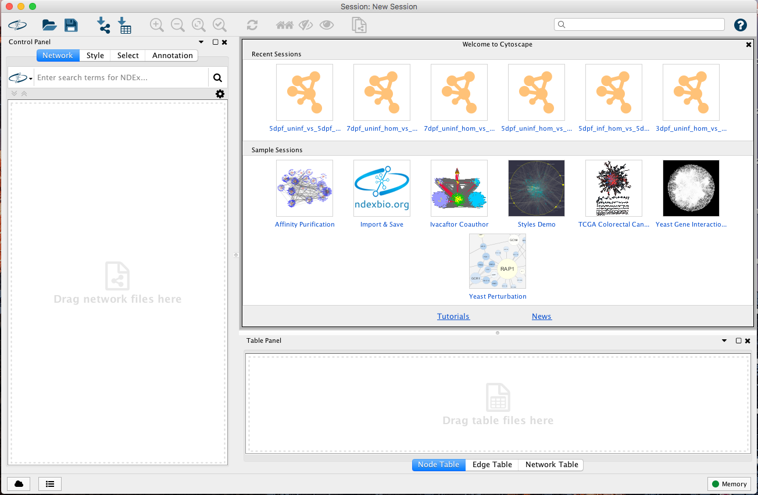

Slide 4
tutorials.cytoscape.org

Slide 5
Loading Networks
Simplest format is Simple interaction file (.sif)
columns are:
Source Node
relationship type
Target Node
ENSDARG00000099966 | geneExprCor | ENSDARG00000095904
ENSDARG00000099966 | geneExprCor | ENSDARG00000086425
ENSDARG00000099966 | geneExprCor | ENSDARG00000104899
ENSDARG00000070656 | geneExprCor | ENSDARG00000038066
ENSDARG00000070656 | geneExprCor | ENSDARG00000019339
ENSDARG00000070656 | geneExprCor | ENSDARG00000095743

Slide 6
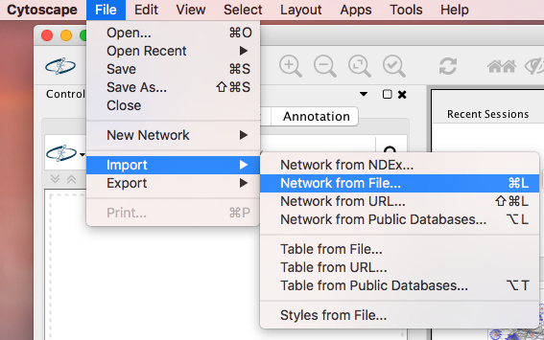
Loading Networks
Simplest format is Simple interaction file (.sif)
columns are:
Source Node
relationship type
Target Node
ENSDARG00000099966 | geneExprCor | ENSDARG00000095904
ENSDARG00000099966 | geneExprCor | ENSDARG00000086425
ENSDARG00000099966 | geneExprCor | ENSDARG00000104899
ENSDARG00000070656 | geneExprCor | ENSDARG00000038066
ENSDARG00000070656 | geneExprCor | ENSDARG00000019339
ENSDARG00000070656 | geneExprCor | ENSDARG00000095743

Slide 7
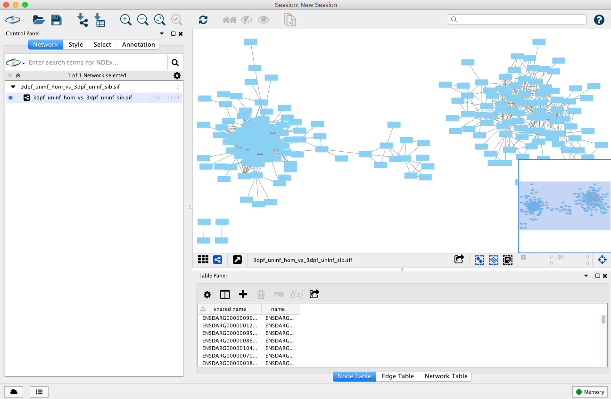
Loading Networks

Slide 8
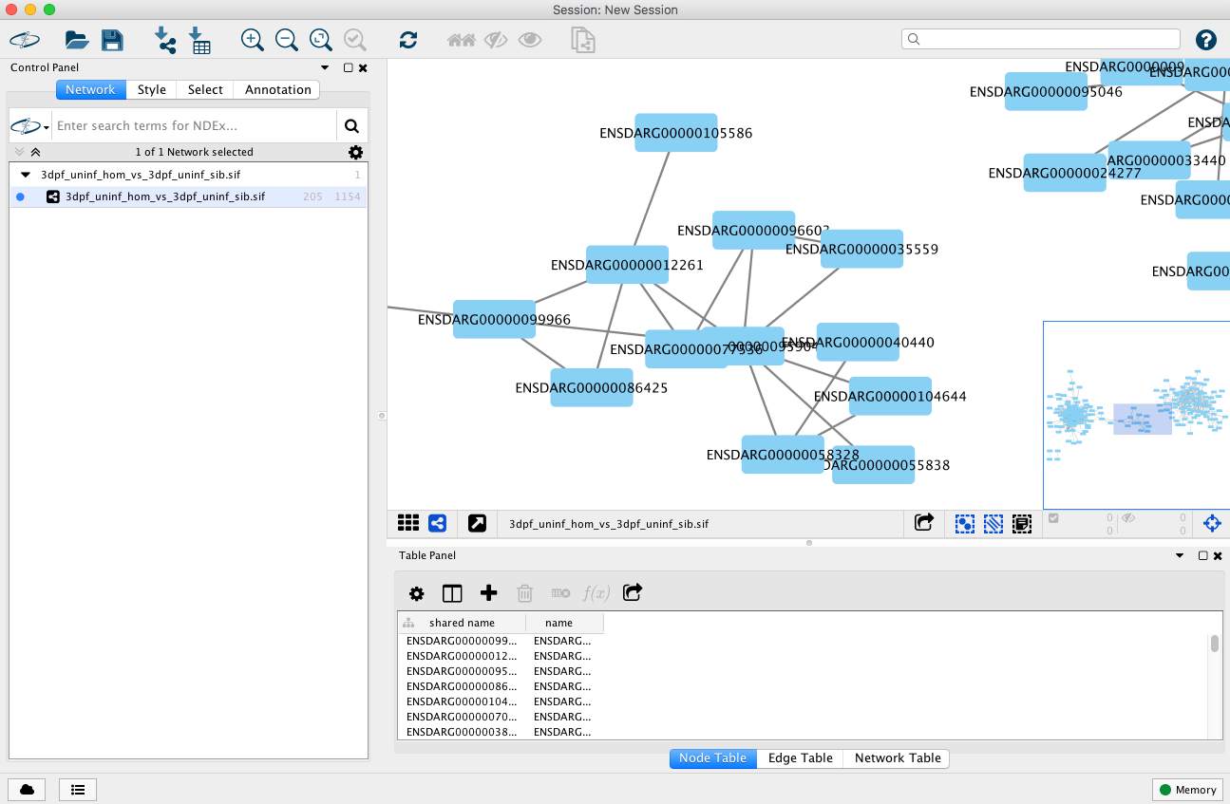
Loading Networks

Slide 9
Add extra node/edge information
Extra node information can be imported from a file containing a column that matches the node names
Gene ID | GeneName | log2fc | adjp
ENSDARG00000099966 | polr2a | 0.773509255 | 1.32E-49
ENSDARG00000070656 | si:ch211-69g19.2 | -0.583759051 | 2.25E-15
ENSDARG00000038066 | kpna2 | -0.520683514 | 5.79E-14
ENSDARG00000037551 | pm20d1.1 | 2.334699018 | 6.79E-11

Slide 10
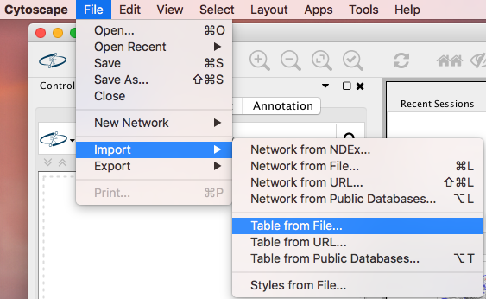
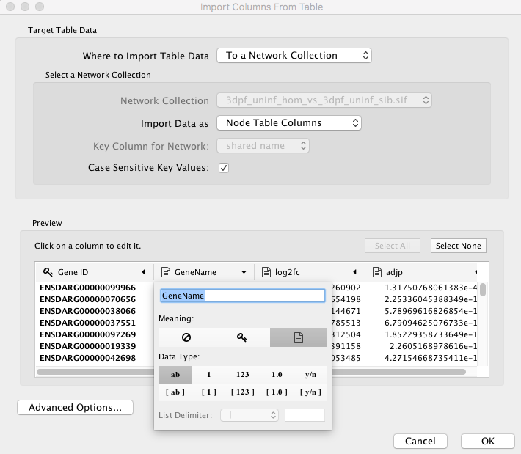
Add extra node/edge information
Extra node information can be imported from a file containing a column that matches the node names
Gene ID | GeneName | log2fc | adjp
ENSDARG00000099966 | polr2a | 0.773509255 | 1.32E-49
ENSDARG00000070656 | si:ch211-69g19.2 | -0.583759051 | 2.25E-15
ENSDARG00000038066 | kpna2 | -0.520683514 | 5.79E-14
ENSDARG00000037551 | pm20d1.1 | 2.334699018 | 6.79E-11

Slide 11
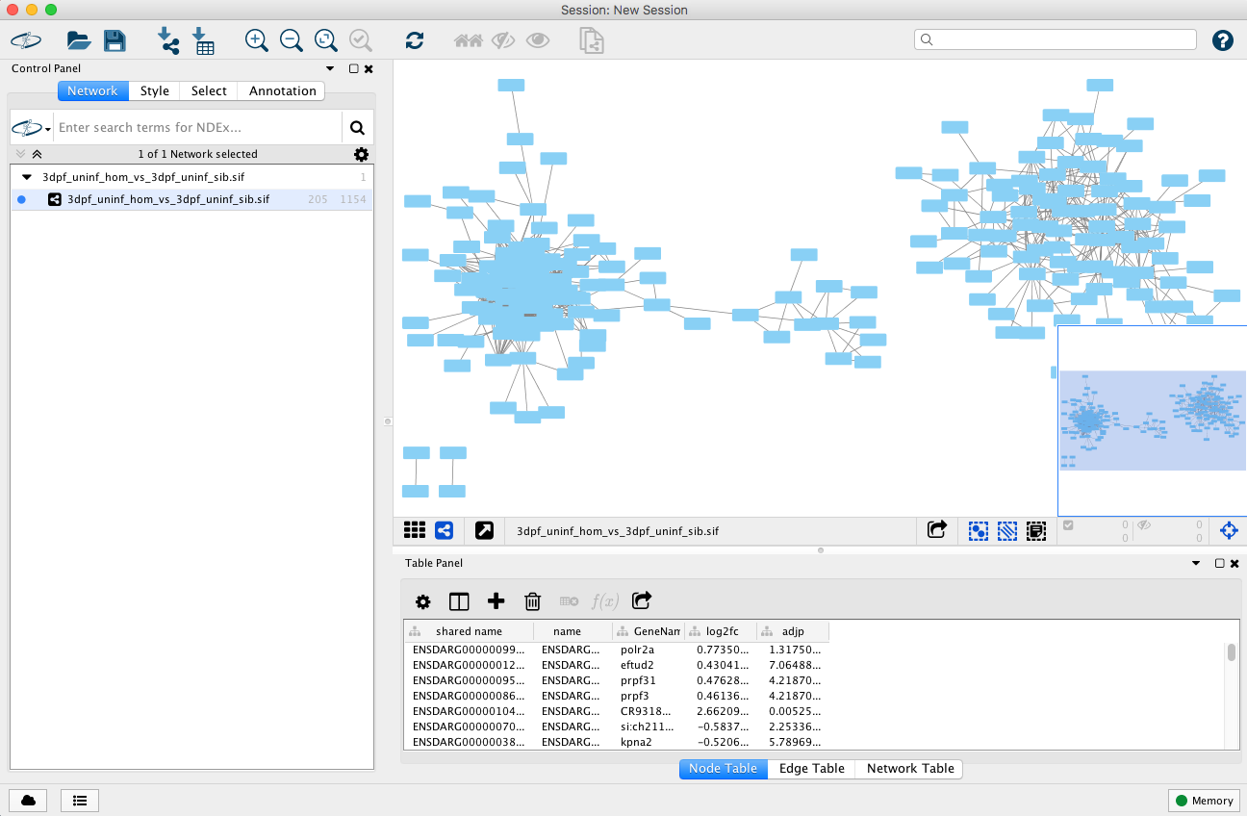
Add extra node/edge information

Slide 12
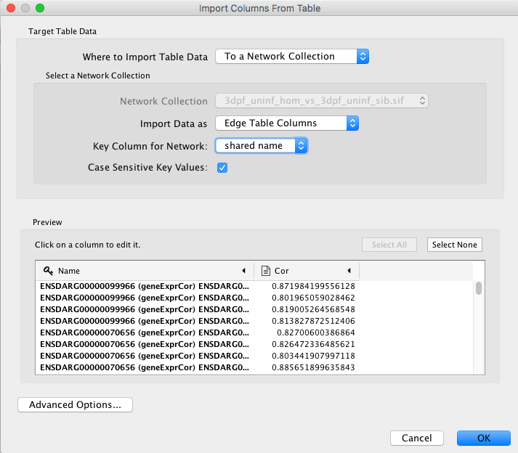
Add extra node/edge information
Extra edge information can be imported in the same way
Name | Cor
ENSDARG00000099966 (geneExprCor) ENSDARG00000012261 | 0.8719842
ENSDARG00000099966 (geneExprCor) ENSDARG00000095904 | 0.801965059
ENSDARG00000099966 (geneExprCor) ENSDARG00000086425 | 0.819005265
ENSDARG00000099966 (geneExprCor) ENSDARG00000104899 | 0.813827873

Slide 13
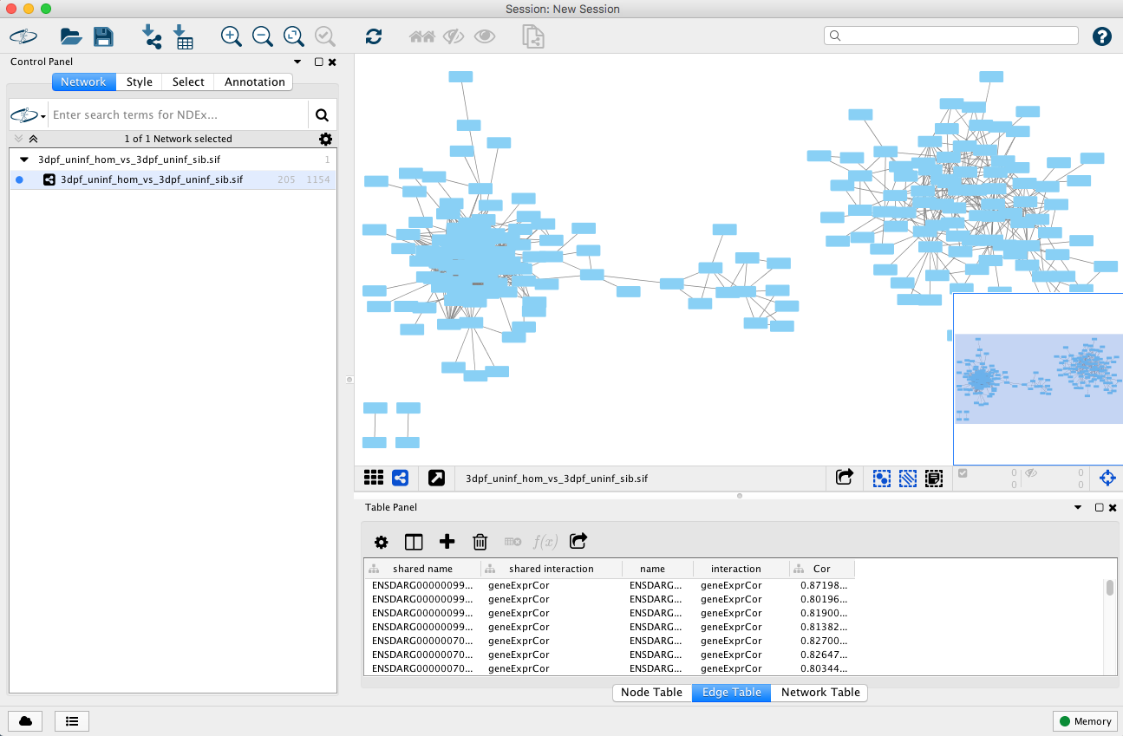
Add extra node/edge information

Slide 14
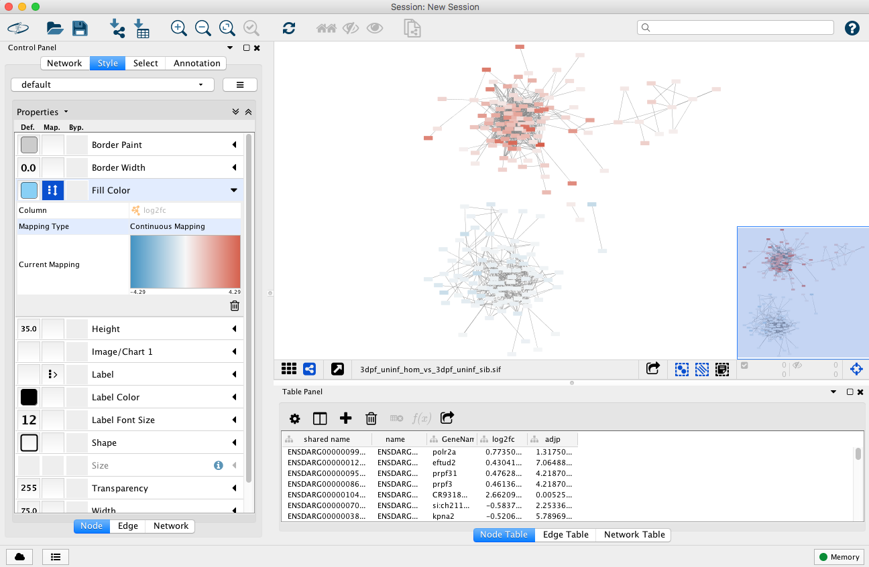
Add styles to nodes

Slide 15
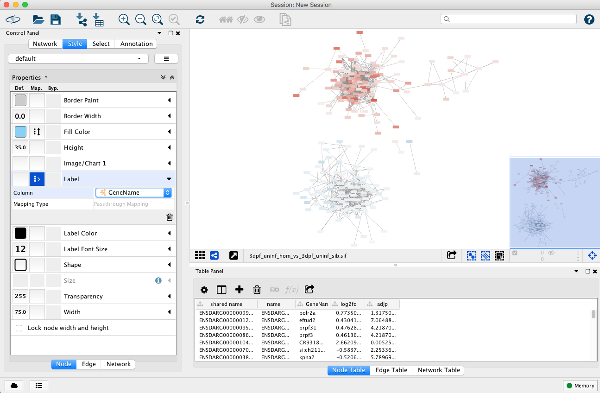
Add styles to nodes

Slide 16
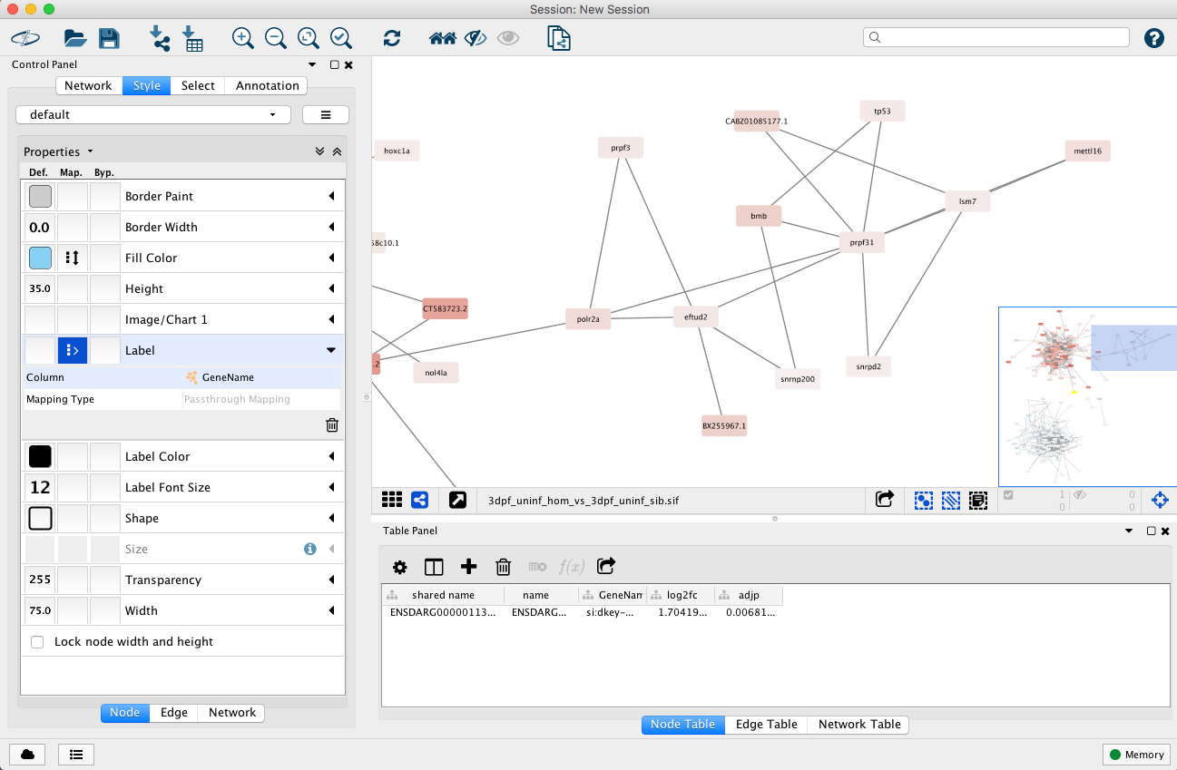
Add styles to nodes

Slide 17
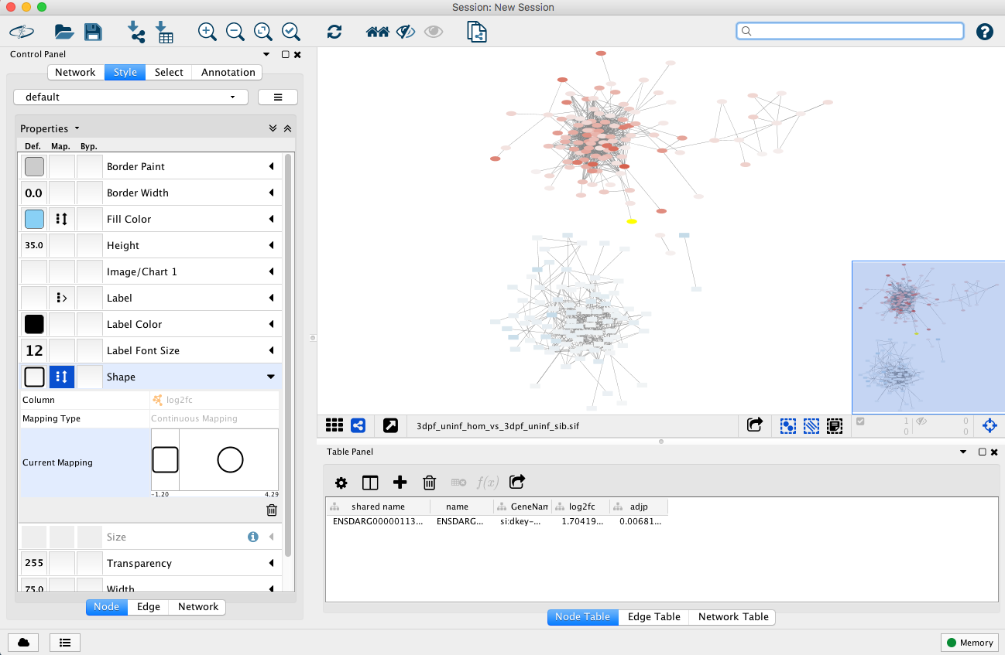
Add styles to nodes

Slide 18
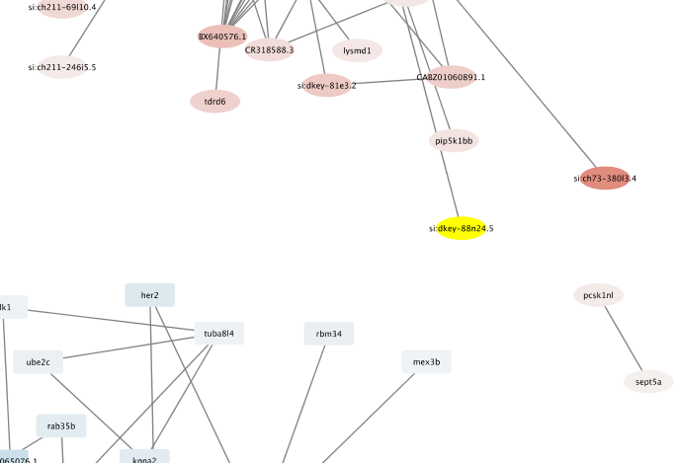
Add styles to nodes

Slide 19
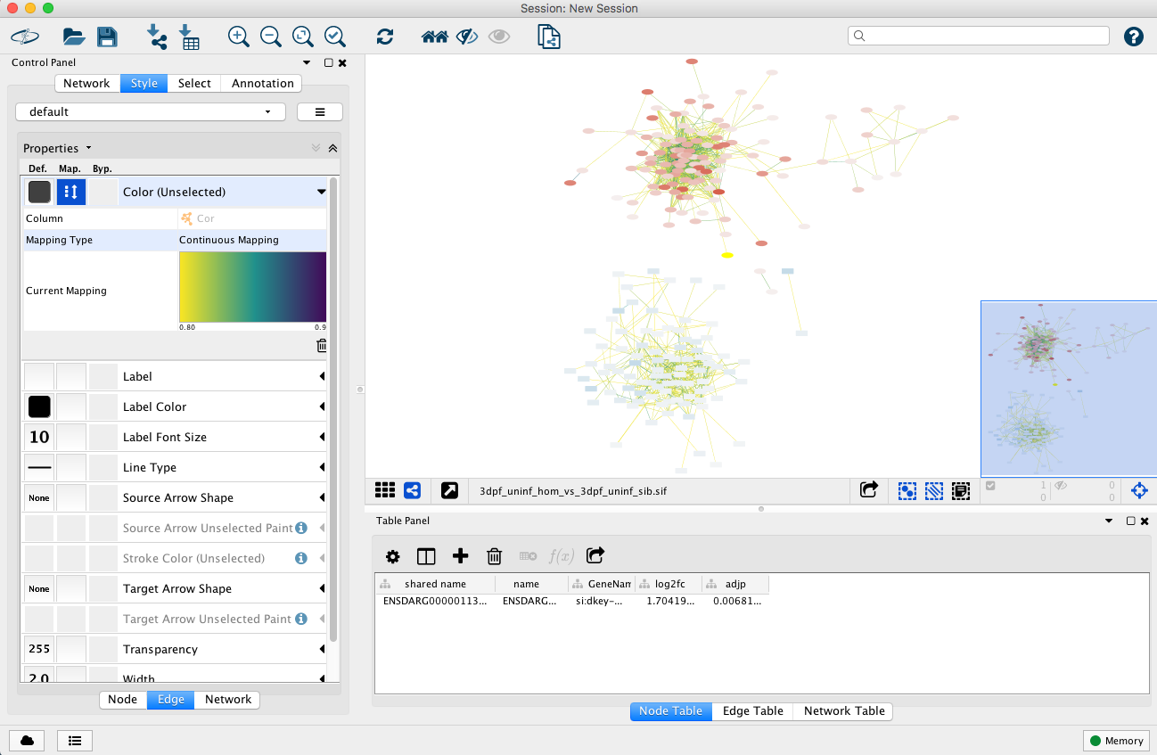
Add styles to edges

Slide 20
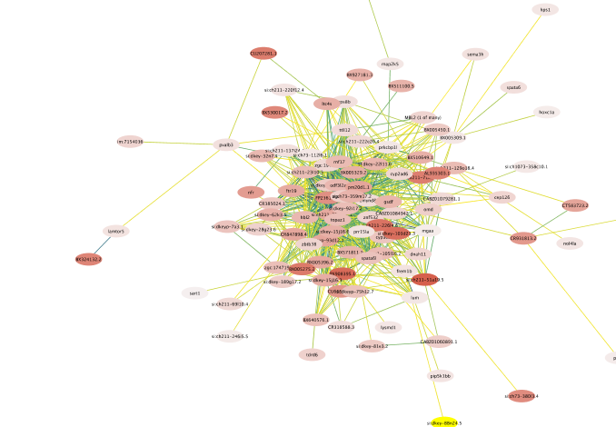
Add styles to edges

Slide 21
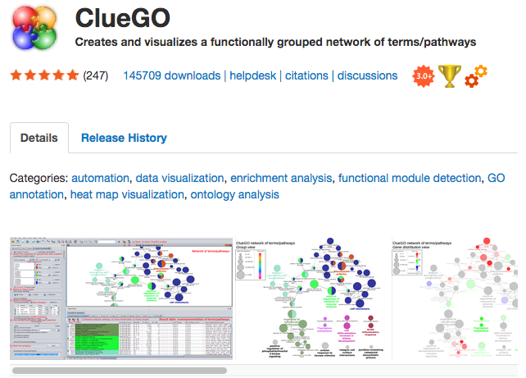
ClueGO
Cytoscape App for visualising functional enrichments
GO/KEGG/Reactome etc.
http://www.ici.upmc.fr/cluego/cluegoDocumentation.shtml
Groups terms to identify non-redundant terms
Bindea et al. 2009

Slide 22

ClueGO
Cytoscape App for visualising functional enrichments
GO/KEGG/Reactome etc.
http://www.ici.upmc.fr/cluego/cluegoDocumentation.shtml
Groups terms to identify non-redundant terms
Bindea et al. 2009

Slide 23
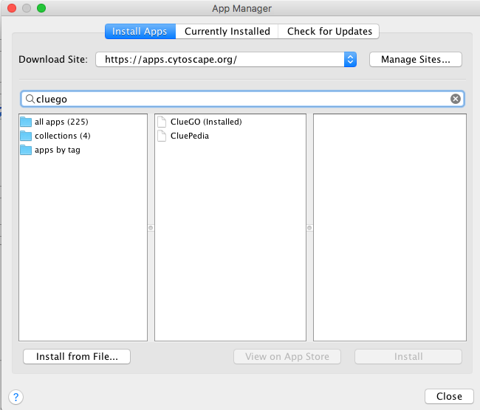
ClueGO
Cytoscape App for visualising functional enrichments
GO/KEGG/Reactome etc.
http://www.ici.upmc.fr/cluego/cluegoDocumentation.shtml
Groups terms to identify non-redundant terms
Bindea et al. 2009

Slide 24
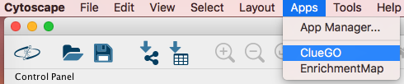
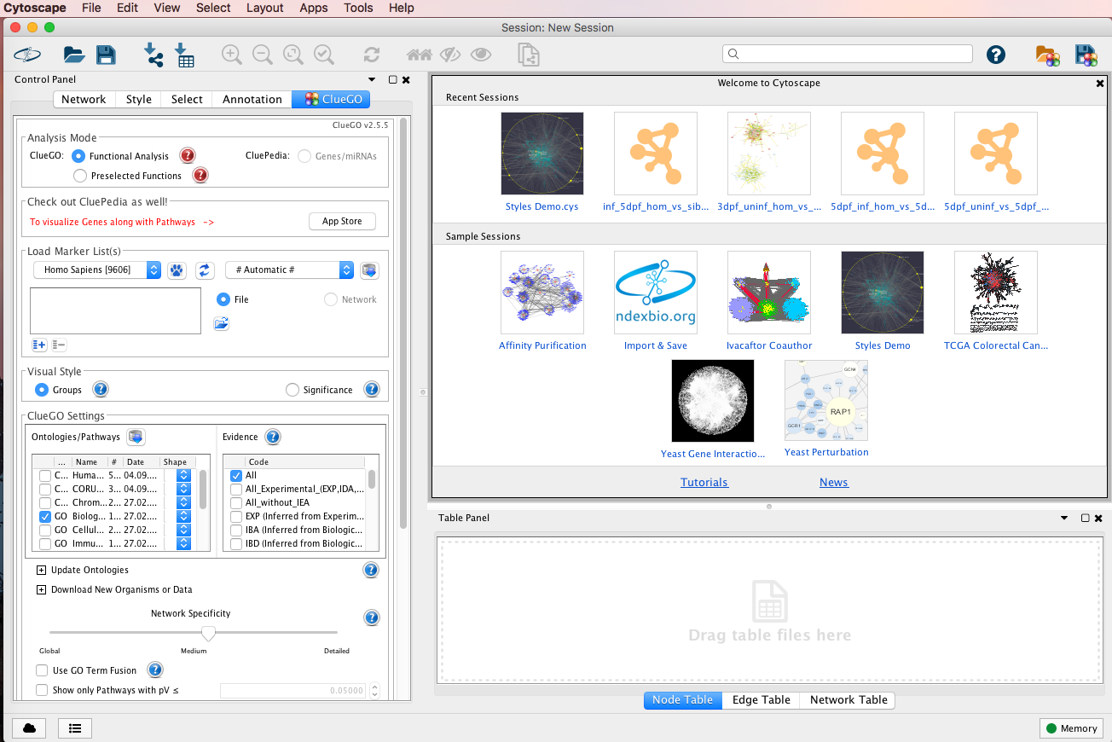
ClueGO

Slide 25
ClueGO

Slide 26
ClueGO

Slide 27
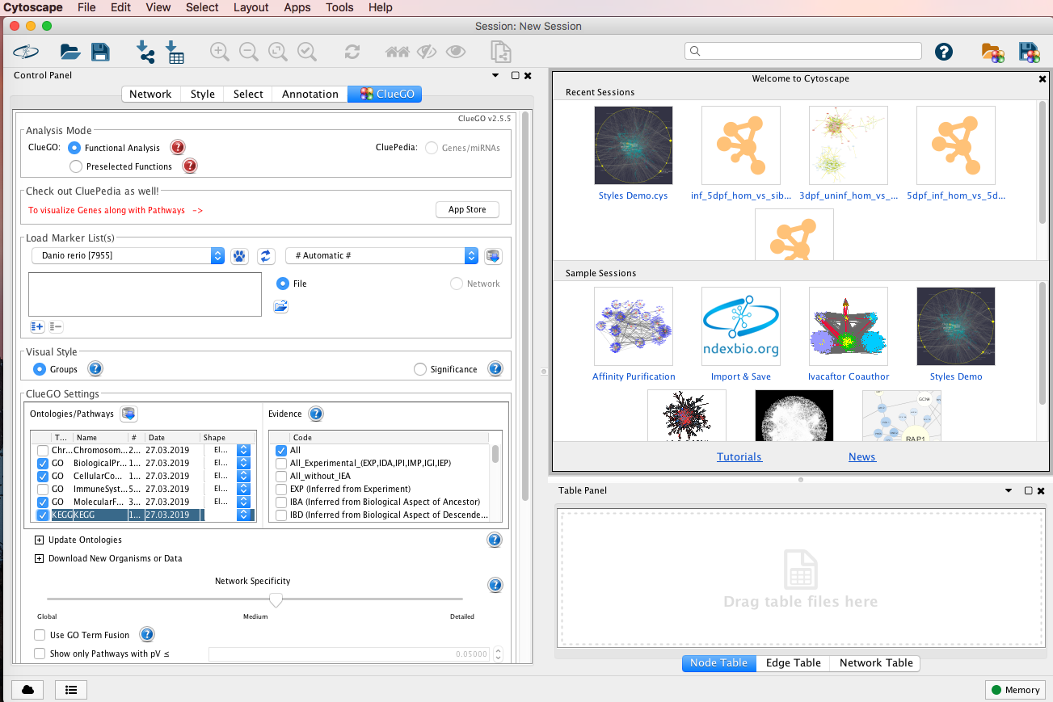
ClueGO

Slide 28

ClueGO

Slide 29
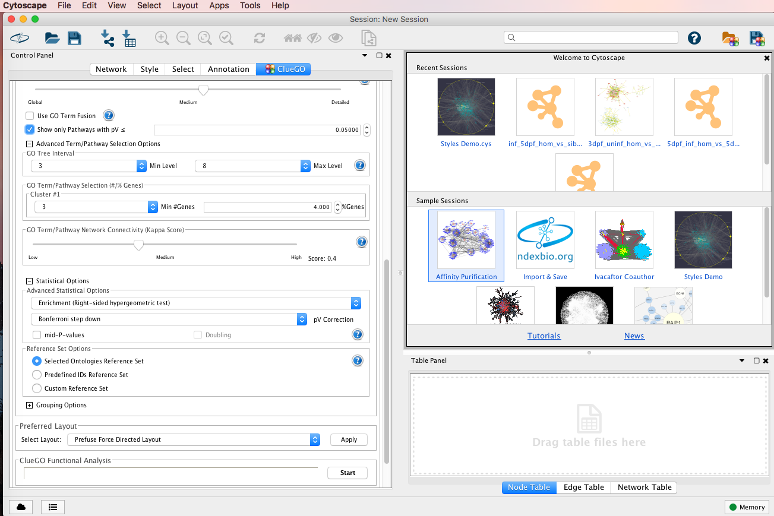
ClueGO

Slide 30
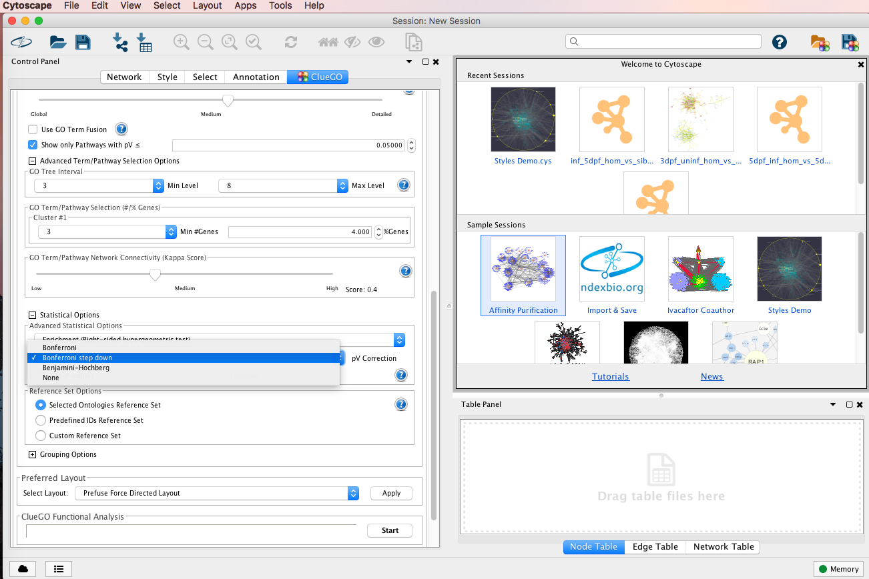
ClueGO

Slide 31
ClueGO

Slide 32
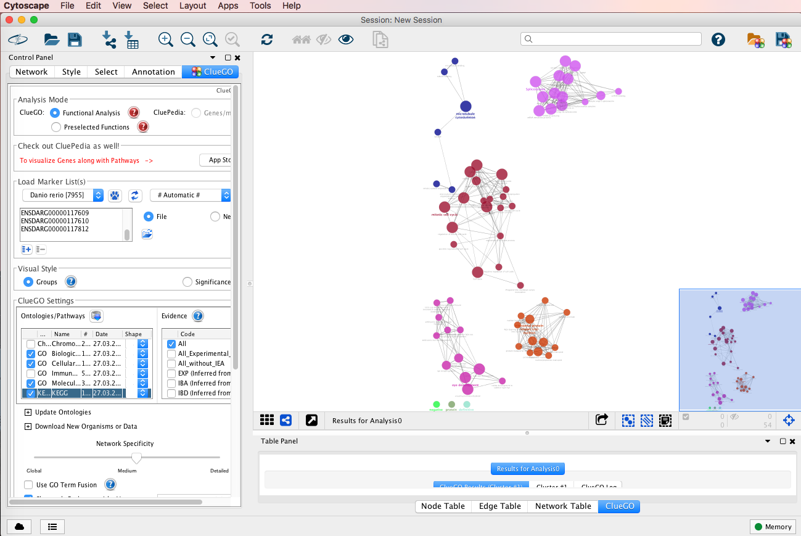
ClueGO

Slide 33
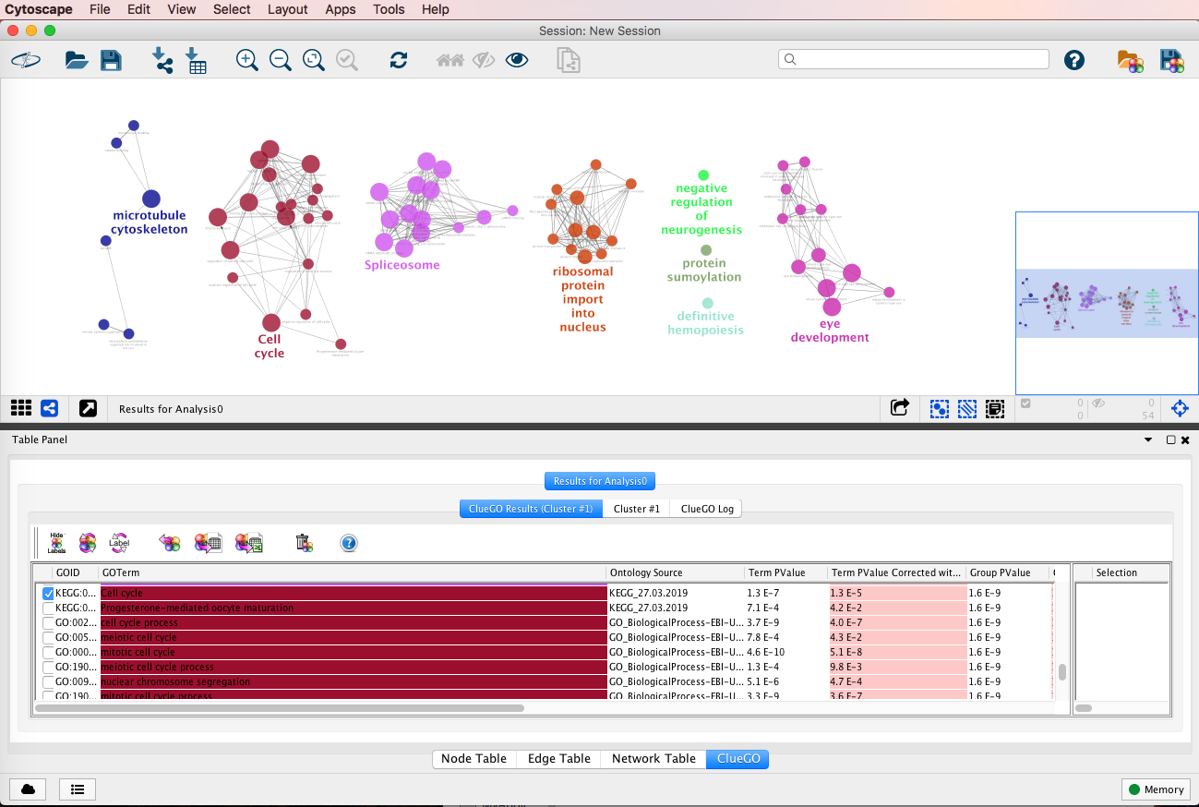
ClueGO

Slide 34
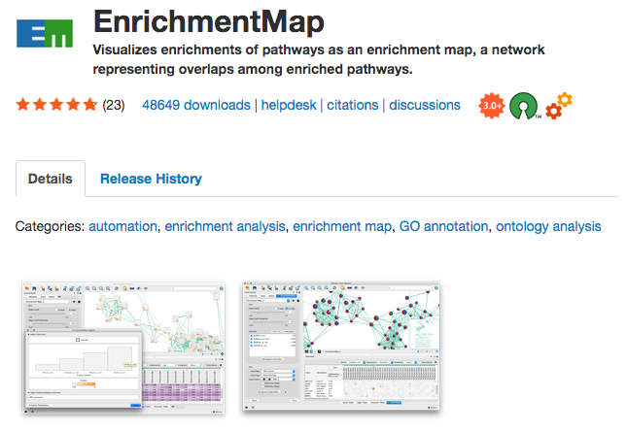
Enrichment Map
https://enrichmentmap.readthedocs.io/en/latest
Inputs:
GSEA
DAVID/BINGO/Great
Generic
Merico et al. 2010

Slide 35
Generic Input Files
Enrichments
GeneSetID | Description | p.Val | FDR | Phenotype
GO:0000070 | mitotic sister chromatid segregation | 6.83E-04 | 0.04165 | 1.38041
GO:0000278 | mitotic cell cycle | 4.64E-10 | 5.10E-08 | 7.29235
GO:0000280 | nuclear division | 3.62E-07 | 3.65E-05 | 4.43731
GeneSets
GeneSetID | Description | Genes
GO:0000070 | mitotic sister chromatid segregation | bub1 | incenp | nusap1 | pds5a | ran
GO:0000278 | mitotic cell cycle | aspm | atoh7 | bmb | bub1 | ccna2 | …
GO:0000280 | nuclear division | bub1 | ccna2 | ccnd1 | ccne2 | incenp | …
Expression
Ranks
name | description | uninf_3dpf_wt_rep1 | uninf_3dpf_wt_rep2
slc35a5 | ENSDARG00000000001 | 36.28229146 | 33.4323
ccdc80 | ENSDARG00000000002 | 75.50639034 | 113.155
nrf1 | ENSDARG00000000018 | 305.9479712 | 281.174
name | rank
slc35a5 | 0.946000588
ccdc80 | 0.987509859
nrf1 | 0.646467578

Slide 36
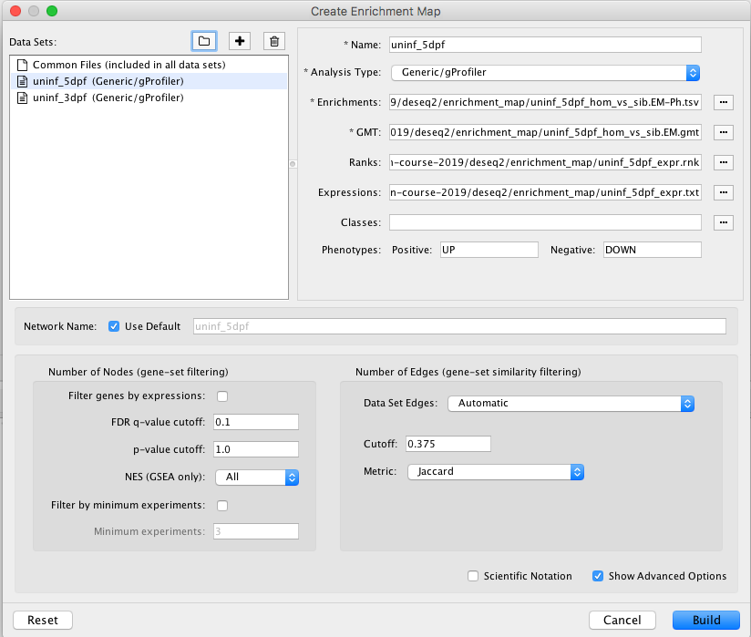
Enrichment Map
https://enrichmentmap.readthedocs.io/en/latest/Parameters.html

Slide 37
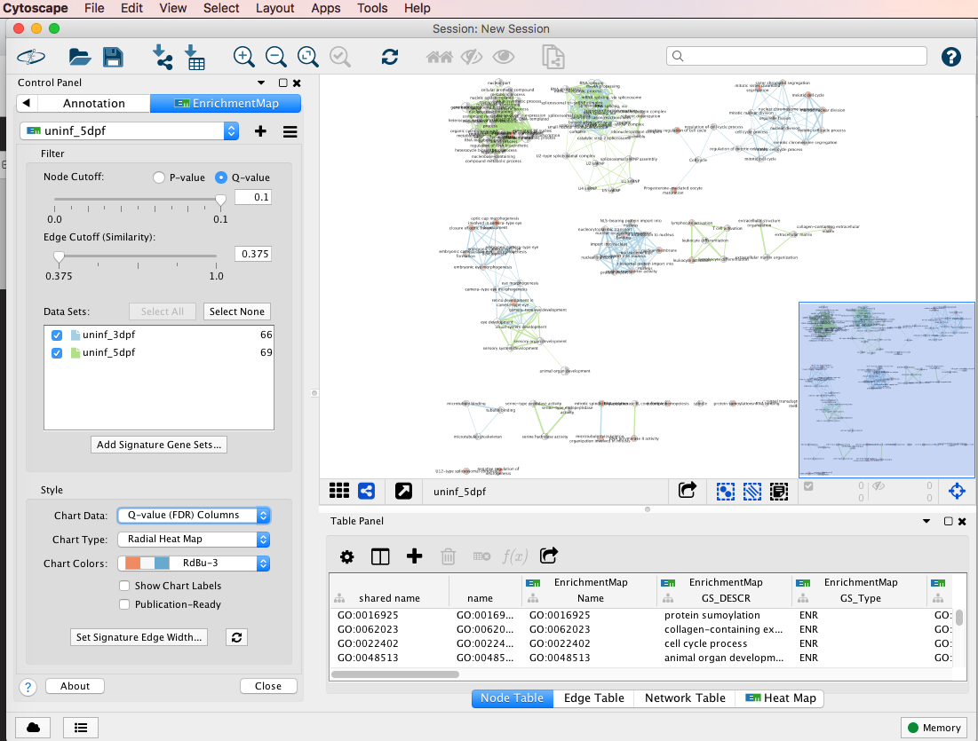
Enrichment Map

Slide 38
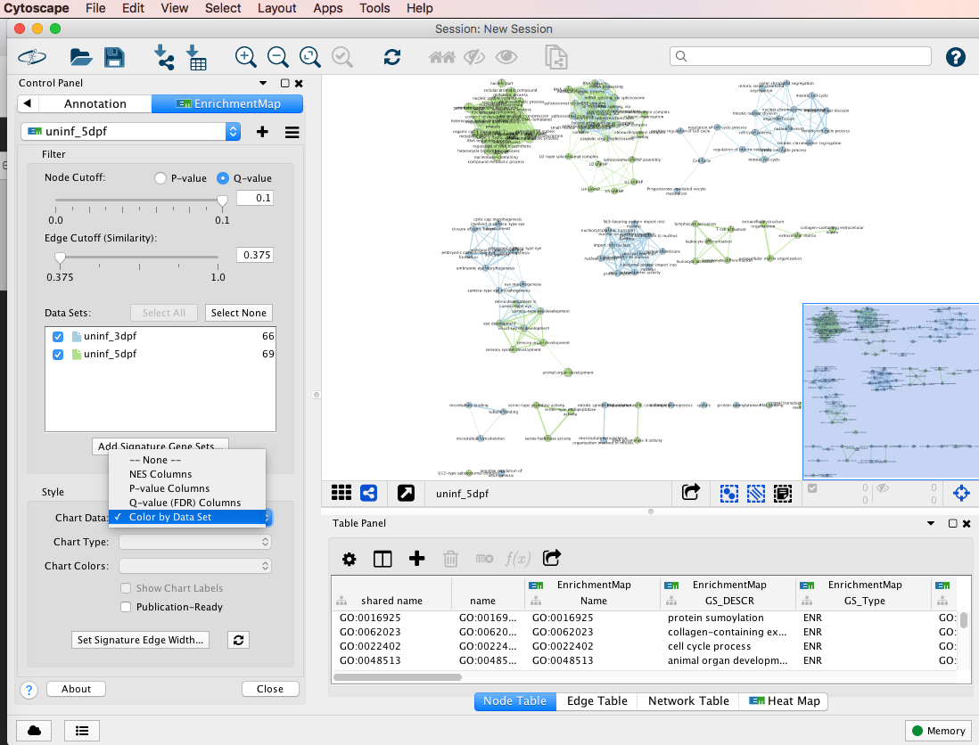
Enrichment Map

Slide 39
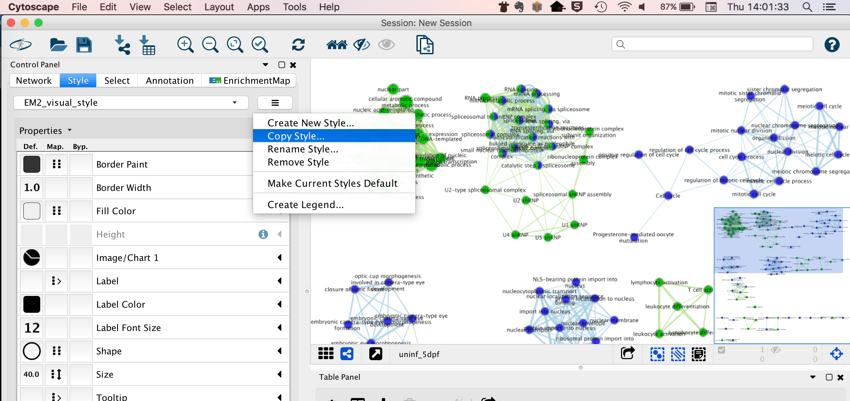
Enrichment Map

Slide 40
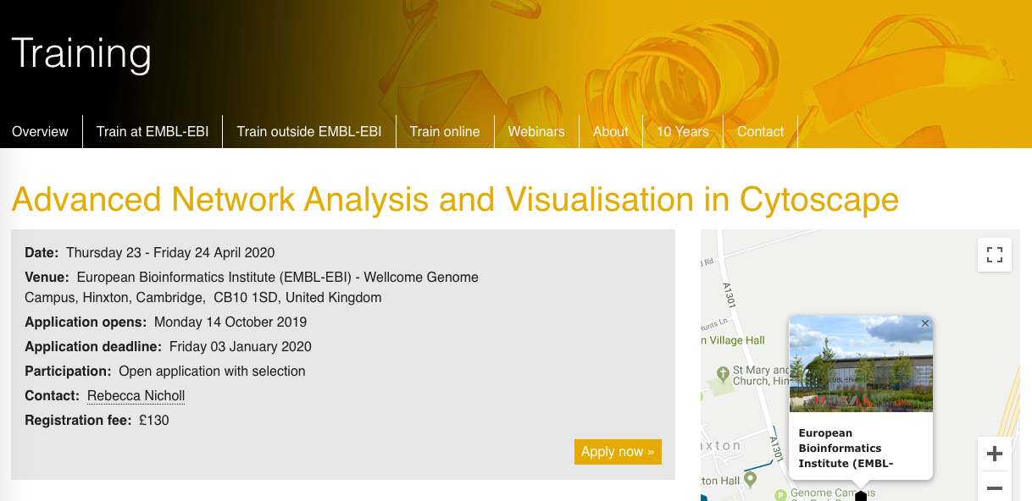
Learning Cytoscape
CytoScape training
https://www.ebi.ac.uk/training/events/2020/advanced-network-analysis-and-visualisation-cytoscape

